Slide 1


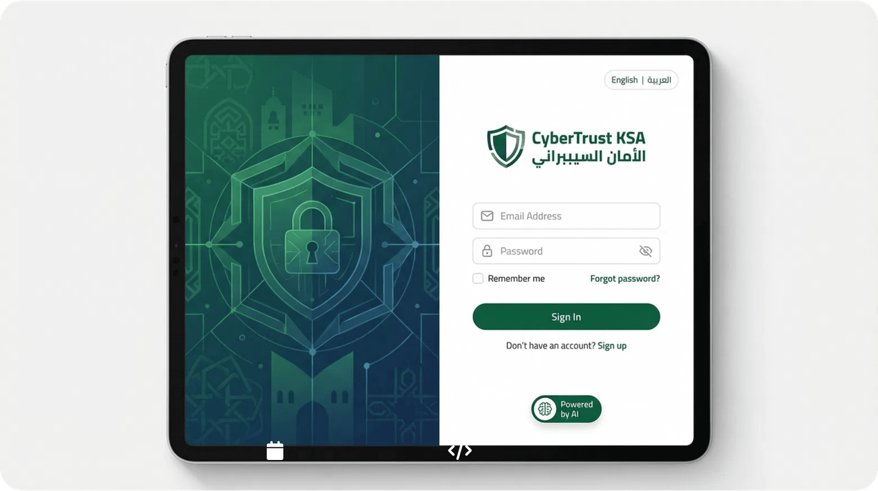
Prototype Design Walkthrough
CyberTrust KSA Platform
منصة الأمان السيبراني السعودية
February 2026 |
Prototype v1.0

Slide 2









User Journey Overview
5 Key Scenarios from Sign-Up to NCA Certification
1
2
3
4
5
User Authentication & Onboarding
Compliance Dashboard Overview
Gap Analysis & Assessment
Virtual CISO Interaction
Cloud Integration Management
AI-powered gap identification across 65 NCA controls with prioritized remediation roadmap
24/7 AI chatbot for compliance guidance, policy generation, and expert recommendations
Secure login with MFA, bilingual interface, and 30-minute guided onboarding process
Real-time compliance score, control status tracking, and actionable insights at a glance
Connect 50+ cloud platforms for automated evidence collection every 15 minutes
Each scenario demonstrates key platform capabilities with actual UI screenshots

Slide 3

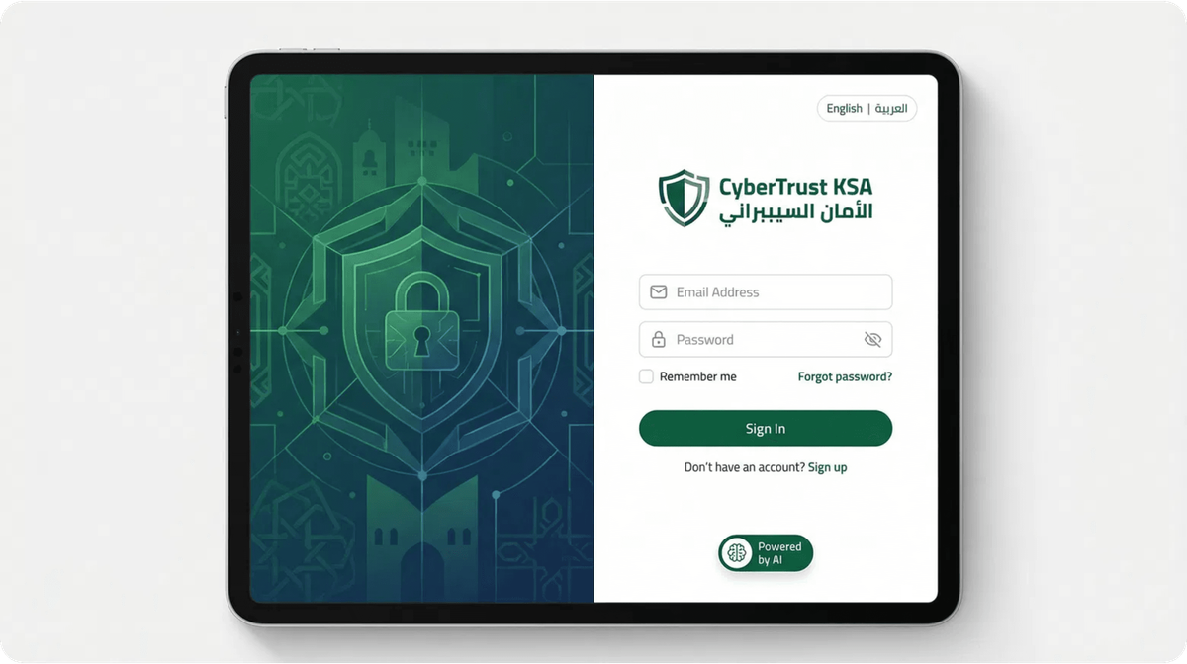
SCENARIO 1
User Authentication & Onboarding
Secure entry point to the CyberTrust KSA platform with multi-factor authentication, bilingual interface support, and guided 30-minute onboarding process.
Key Features Demonstrated:
Multi-Factor Authentication: OAuth 2.0 with TOTP/SMS verification for enhanced security
Bilingual Support: Seamless switching between English and Arabic interfaces
SSO Integration: SAML 2.0 and OpenID Connect for enterprise authentication
Guided Onboarding: Step-by-step setup wizard completing in 30 minutes
Role-Based Access: Customizable permissions for CISO, compliance officers, and auditors

Slide 4







SCENARIO 2
Compliance Dashboard Overview
Real-time monitoring of compliance status, controls, and evidence collection
Compliance Score
Total Controls
Gaps Identified
Evidence Collected
87%
65
8
1,247
+5% this week
NCA ECC Framework
4 high priority
Auto-collected 24/7
Real-Time Monitoring
Quick Actions & Insights
Live compliance score updated every 15 minutes
One-click gap remediation guidance
Control status tracking across all 65 NCA controls
Automated report generation for stakeholders
Instant drift detection with automated alerts
Recent activity feed with audit trail
Historical trend analysis and predictive insights
Customizable widgets and role-based views
Start Gap Analysis
Ask Virtual CISO
Manage Integrations
Generate Report

Slide 5

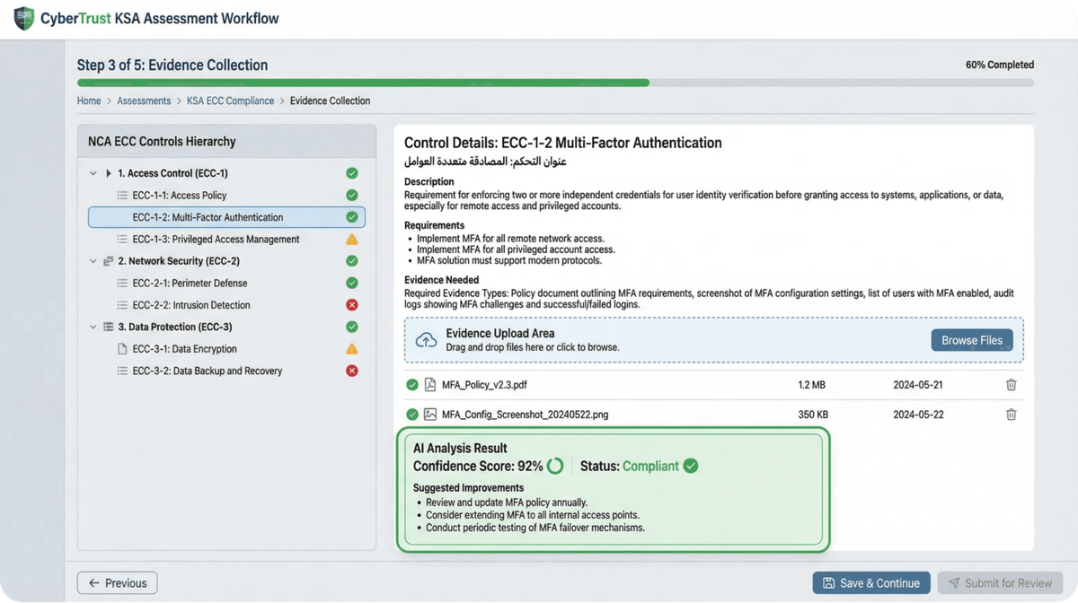
SCENARIO 3
Gap Analysis & Assessment
AI assessment scans your security posture against NCA requirements, finds gaps, and gives a prioritized remediation roadmap.
Key Features Demonstrated:
NCA Control Mapping: Auto-maps evidence to 65 controls
Gap Identification: Real-time detection across domains
Risk Prioritization: Rank gaps by criticality and impact
Remediation Guidance: Step-by-step fixes with effort estimates
Progress Tracking: Visual dashboard for closure progress

Slide 6
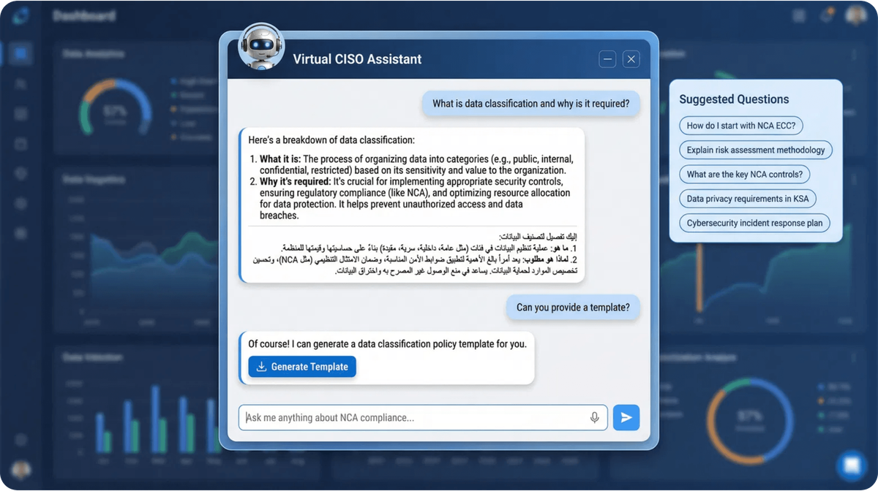
SCENARIO 4
Virtual CISO Interaction
24/7 AI-powered compliance expert trained on 10,000+ Saudi regulatory documents, providing instant guidance in Arabic and English.
Key Features Demonstrated:
AI-Powered Guidance: GPT-4 model fine-tuned on NCA ECC, PDPL, SAMA frameworks
Bilingual Support: Natural conversation in Arabic and English with context awareness
Policy Generation: Create customized security policies in 2 minutes based on NCA requirements
Gap Remediation: Step-by-step guidance for closing compliance gaps with implementation examples
Control Interpretation: Detailed explanations of NCA controls with Saudi-specific context

Slide 7
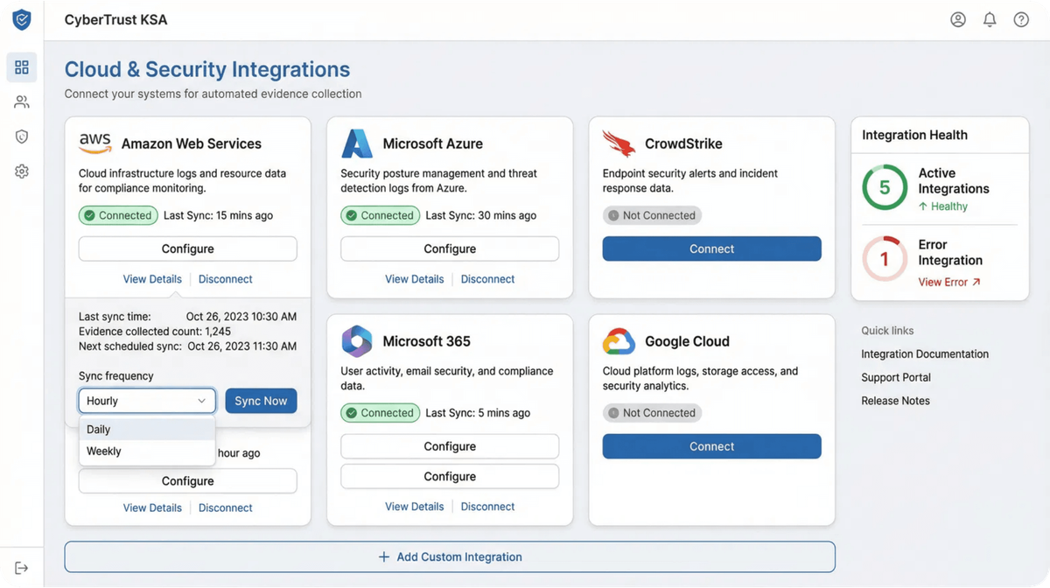
SCENARIO 5
Cloud Integration Management
Connect to 50+ cloud platforms and security tools for automated evidence collection every 15 minutes, eliminating 80% of manual compliance work.
Key Features Demonstrated:
50+ Cloud Integrations: AWS, Azure, Google Cloud, Microsoft 365, CrowdStrike, Palo Alto Networks
Automated Evidence Collection: Real-time data sync every 15 minutes with OAuth 2.0 authentication
One-Click Setup: Pre-configured integration templates with guided configuration wizards
Integration Health Monitoring: Real-time status tracking with instant alerts for connection issues
Custom API Support: RESTful API and webhooks for proprietary tool integrations

Slide 8
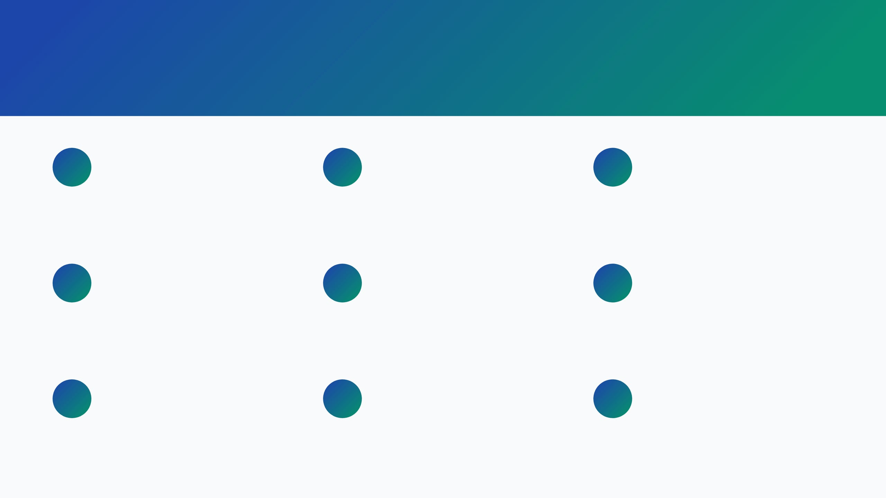









Key UI/UX Features Demonstrated
Design Principles & User Experience Highlights Across All Scenarios
Bilingual Support
Accessibility First
Mobile Responsive
Seamless Arabic and English interface with RTL layout support and culturally adapted content
WCAG 2.1 AA compliant with keyboard navigation, screen reader support, and high contrast modes
Fully responsive design optimized for desktop, tablet, and mobile devices with native apps
Real-Time Updates
Consistent Design System
Data Visualization
Live compliance score updates every 15 minutes with WebSocket connections for instant notifications
Unified color palette, typography, and spacing following enterprise SaaS best practices
Interactive charts and graphs using D3.js and Chart.js for compliance metrics and trends
Role-Based Views
Security-First Design
Performance Optimized
Customized dashboards for CISO, compliance officers, executives, and auditors
Zero-trust architecture with session management, audit trails, and encrypted data transmission
Sub-200ms API response times, lazy loading, and optimized asset delivery for fast page loads

Slide 9

Development Roadmap & Next Steps
From Prototype to Production: Q2-Q4 2026 Timeline
1
2
3
4
Prototype Validation
User Testing
Development Sprint
Production Launch
Q2 2026 (4 weeks)
Q2 2026 (6 weeks)
Q3 2026 (12 weeks)
Q4 2026 (4 weeks)
Stakeholder feedback sessions
Beta testing with 10 pilot customers
Full-stack implementation (Python/MySQL)
Infrastructure deployment (AWS/Azure)
UI/UX refinement based on input
Usability testing sessions
AI model training and integration
Final security audit and penetration testing
Performance and load testing
Technical architecture review
Accessibility compliance validation
Cloud integrations development
Go-to-market campaign execution
Security audit and compliance check
Mobile app development (iOS/Android)
Official launch with 100 customers target
Contact Information
info@cybertrustksa.com
Ready to Get Started?
+966 11 123 4567
Schedule a demo or join our beta program
www.cybertrustksa.com

